Slide 1

Lecture
on
“Advanced Computer Architecture –TCS 704”
by
Akansha Gupta
DEPARTMENT OF COMPUTER SCIENCE AND ENGINEERING
GRAPHIC ERA DEEMED TO BE UNIVERSITY – 248002

Slide 2
TRENDS IN COST
Factors That Influence The Cost Of A Computer:
Time
--Larger volume increases rate of the learning curve. (Products get cheaper to manufacture more quickly).
Volume
--Volume decreases cost due to increases in manufacturing efficiency.
Commodification
--Development cost amortization allows cost to get closer to selling price.

Slide 3
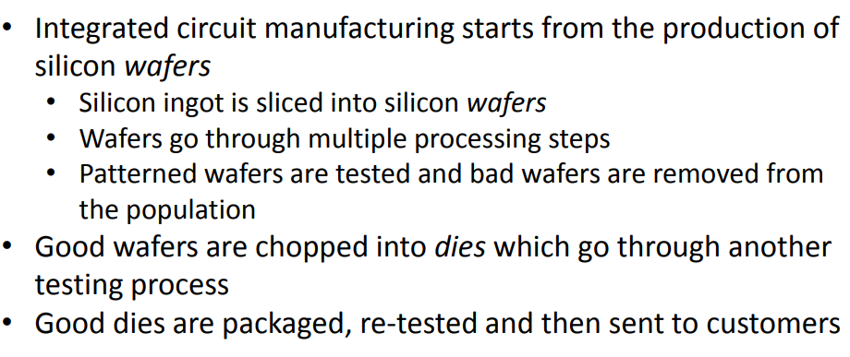
COST OF AN INTEGRATED CIRCUIT- IC Manufacturing

Slide 4
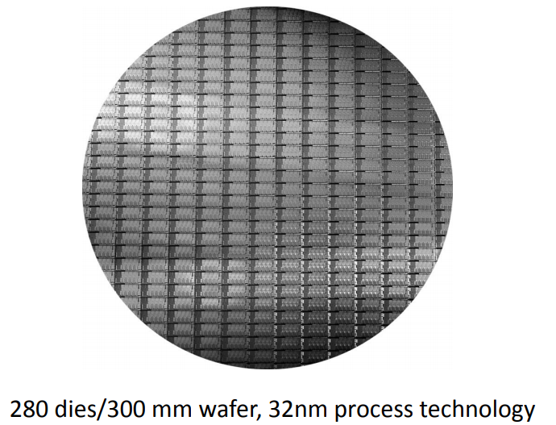
Example: Intel Sandy Bridge

Slide 5
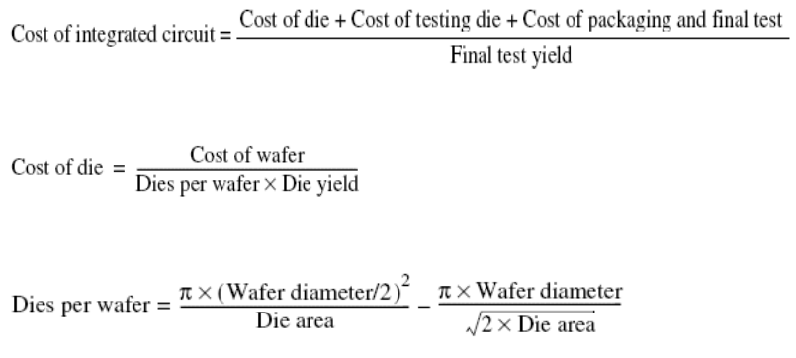
Cost of an Integrated Circuit
Die Cost goes roughly with die area4

Slide 6
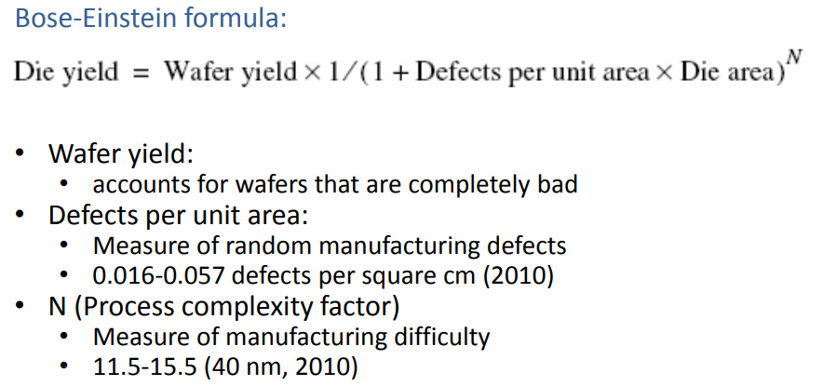
Cost of an Integrated Circuit

Slide 7
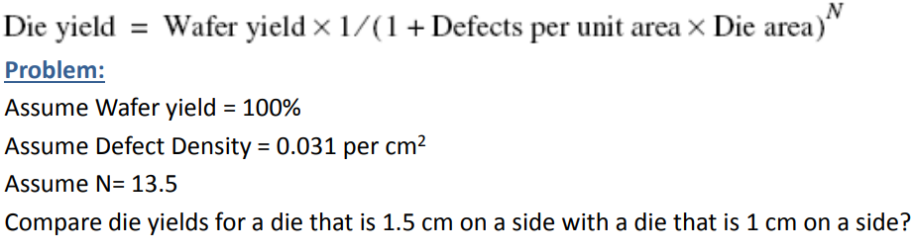
Yield Example

Slide 8
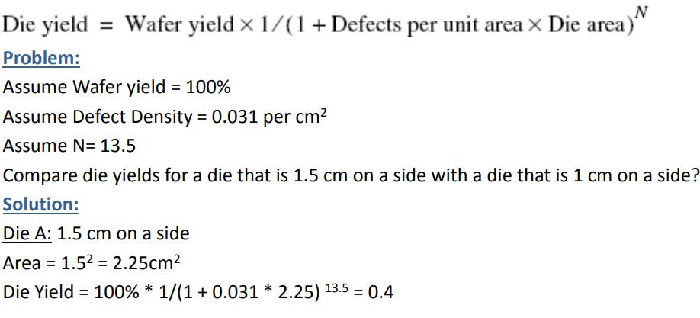
Yield Example

Slide 9
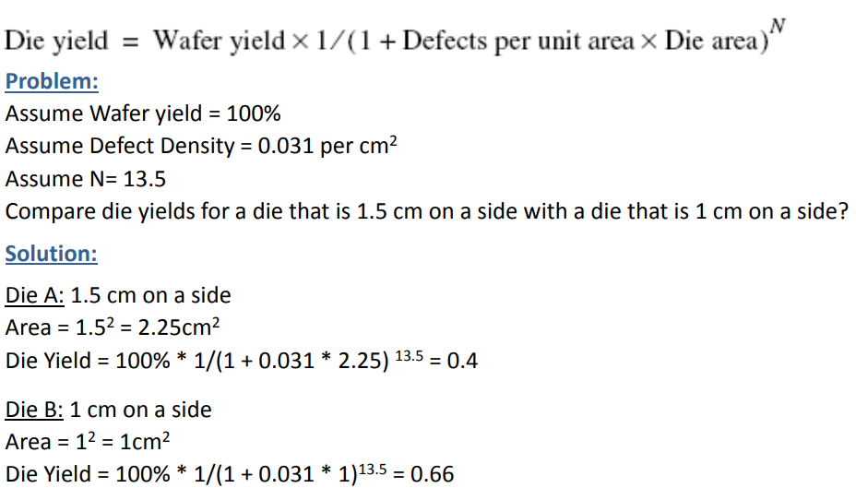
Yield Example

Slide 10
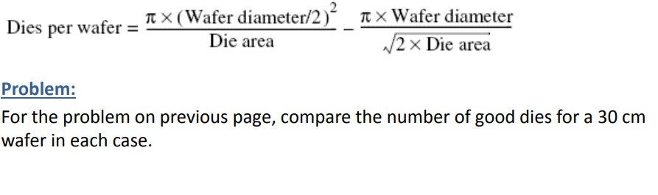
Yield Example (cont.)

Slide 11
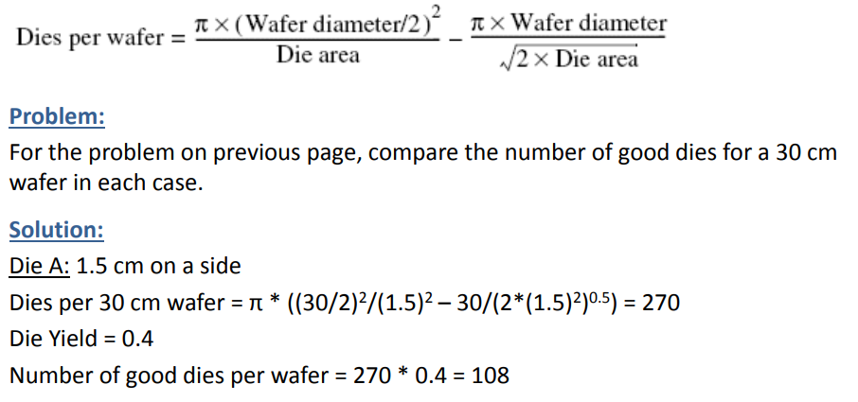
Yield Example (cont.)

Slide 12
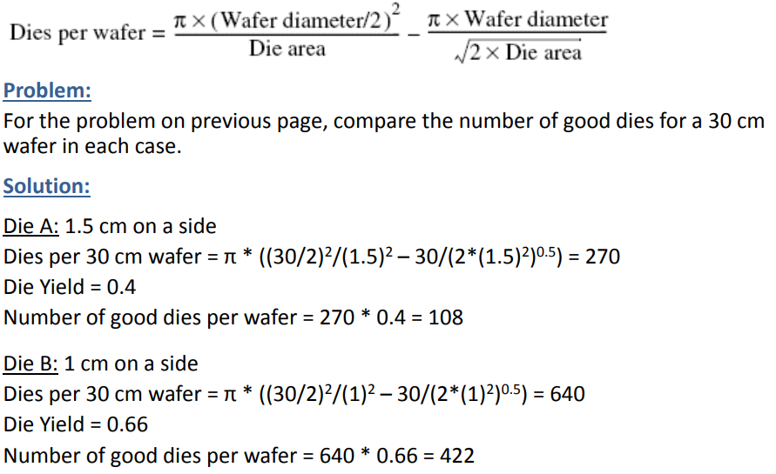
Yield Example (cont.)

Slide 13
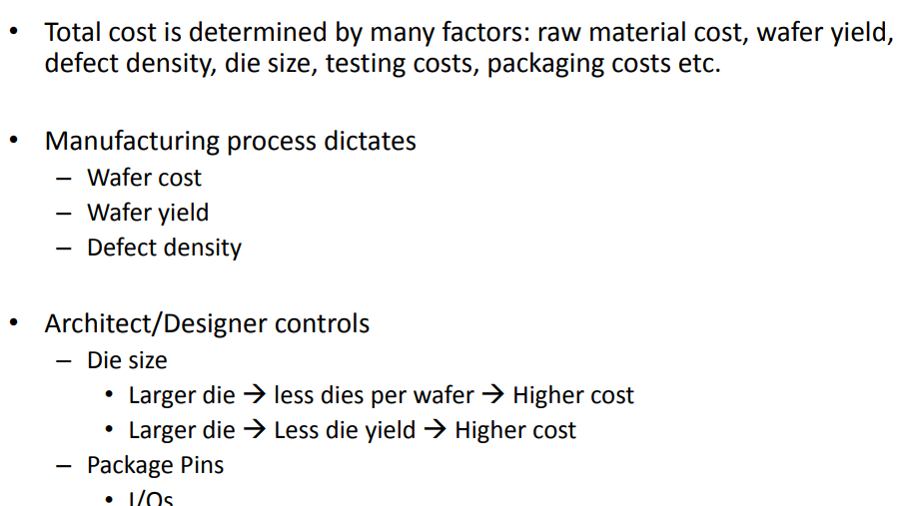
Cost Summary

Slide 14
Cost vs. Price
COST
Cost is typically the expense incurred for creating a product or service being sold by a company.
The costs involved in manufacturing might include the raw materials used in making the product.
The amount of cost it takes to produce a product can have a direct impact on both the price of the product and the profit earned from its sale.
PRICE
Price is the amount a customer is willing to pay for a product or service.
The difference between the price paid and the costs incurred is the profit. If a customer paid $10 for an item that cost $6 to produce and sell, the company earned $4 in profit.

Slide 15
https://youtu.be/yljb0x7MCtc
THANKS

